Slide 1
Questionnaires are not like blood tests: the art and craft of measurement in psychotherapy
Chris Evans
Notes:
Said that I was going to be bit provocative but that I think the tendency to treat questionnaire and other self-report data as equivalent to natural science measurements is wrong and potentially dangerous. I’m not saying we shouldn’t use such measures, in fact I believe strongly that we should use them, but I am sure we need to use them much more thoughtfully than we seem to in 2024.

Slide 2
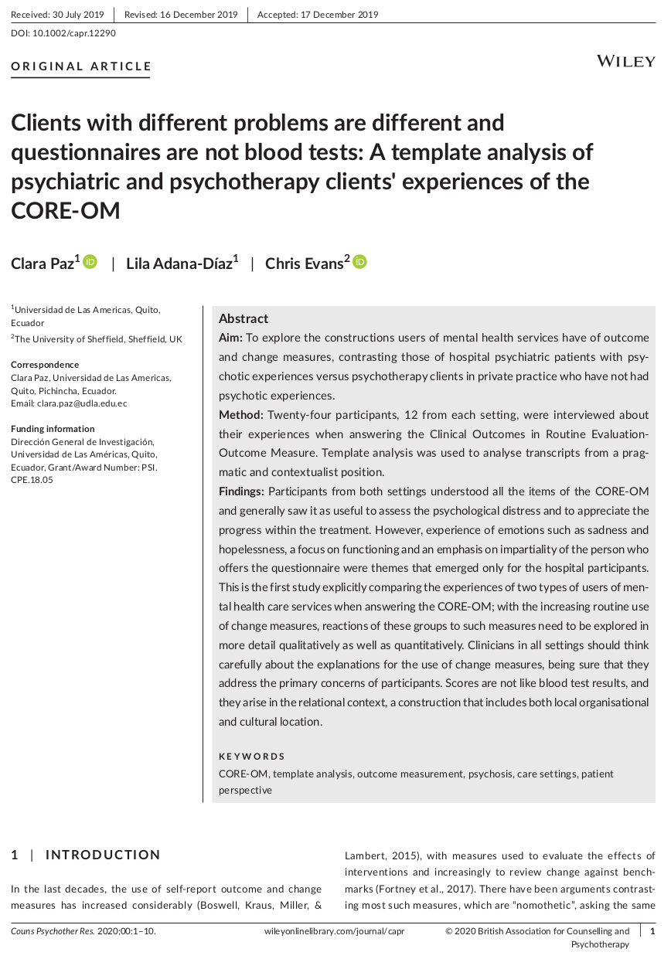
Notes:
The title for this talk comes out of a paper Clara and I published with Lila back in 2019 but the issues have been important for me for, hm, 40 years!

Slide 3
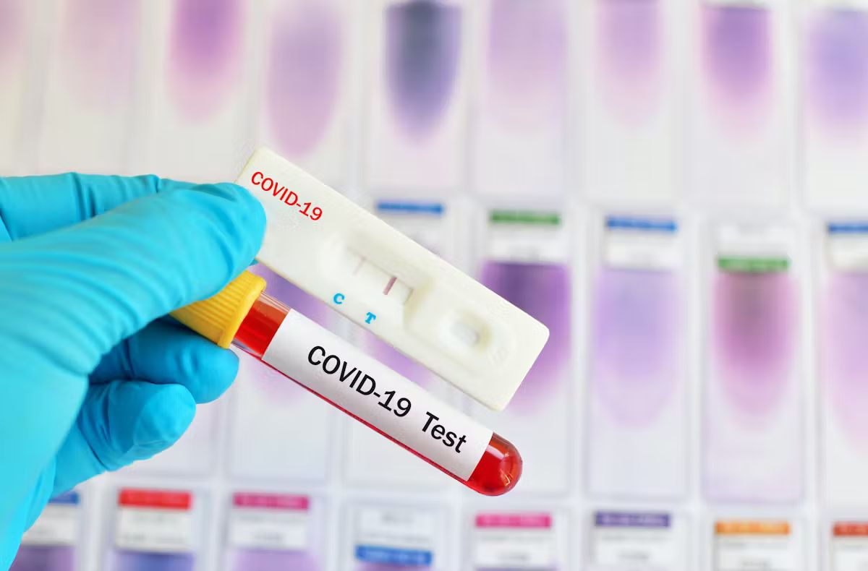
Outline
In the psych[o|i] fields we implicitly or explicitly equate our measures with blood tests
I am hoping to persuade you that this is dangerous. The route is:
  Epistemology
  Methodology
    Mappings
    Units of analysis
  Implications
Notes:
Map through the talk

Slide 4
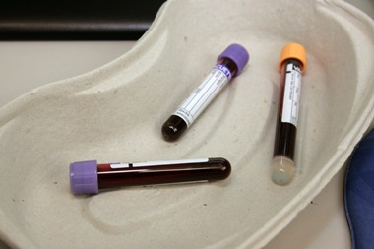
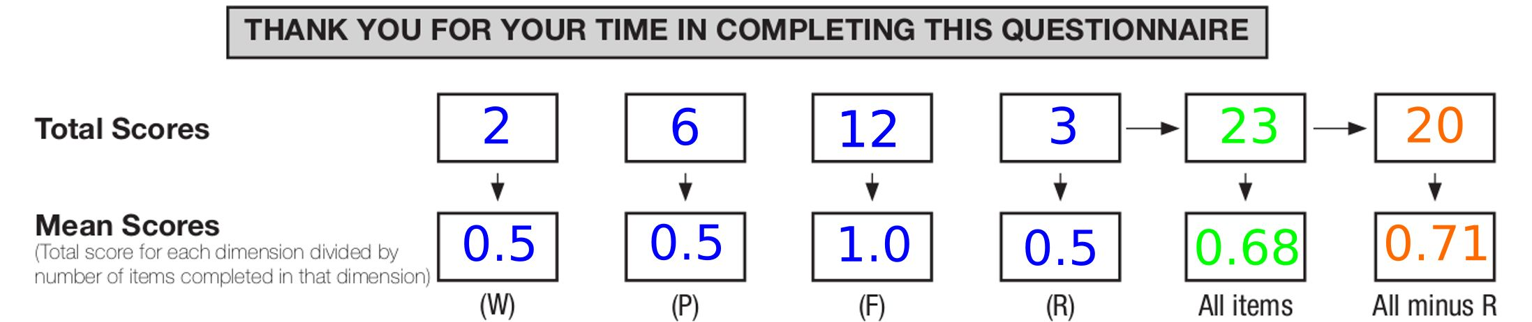
Progress!
Epistemology
Methodology
  Mappings
  Units of analysis
Implications
Summarising
Notes:
OK, to begin at the beginning.

Slide 5
“How is it that we think we know what it is that we think we know?”
(Evans, c. 1984)
Epistemology
Notes:
Which takes me back to 1984 when I started in MH work and what I then decided was my driving research interest. That has remained true and this talk is about one element of that work.

Slide 6
Epistemology
My position is a mix of:
  Critical realist: I do think the idea that there is an external world is useful, I just think we can know it other than by discourse about it.
  Contextual: I see those discourses as located in settings, often professions, with preferred modes of discourse.
  Pragmatic: I’m largely interested in evidential value in terms of utility.
Notes:
At the time I didn’t really know the word “epistemology” and I’m still not very knowledgeable about philosophy but I do at least now have a hybrid epistemological position!

Slide 7
Differences (epistemologically)
Blood tests
I think there is an external: blood, with components
I think we have tools to measure the components
I think those externals, i.e. blood components are there in all of us …
… and that our components vary importantly
Questionnaires
I think we have “internal” states that matter, are powerful
We communicate and leak information about them
These internals may reflect “external” knowables (fMRI, electrode probes) but that’s not usable

Slide 8
Differences (pragmatically)
Blood tests
Can test the same samples many times
Can create liquids of known glucose content
These create referential samples
Beyond allowing the test (if conscious) the client cannot change the value at the moment of testing
Questionnaires
One person can only complete one qu’aire once at any one time
There are no referential values (this is a “1.7 person”)
Clients are active in creating their scores
They depend on client understanding the text

Slide 9
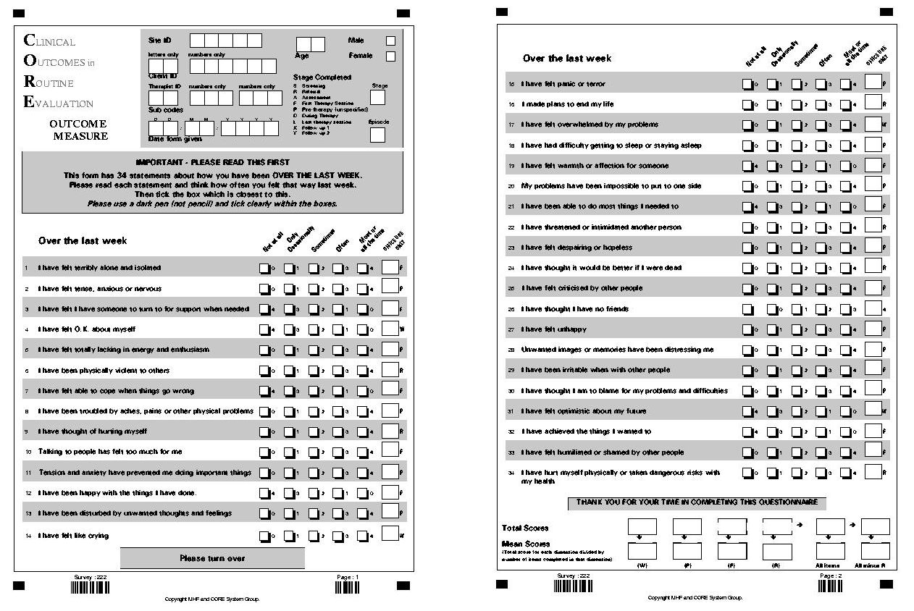
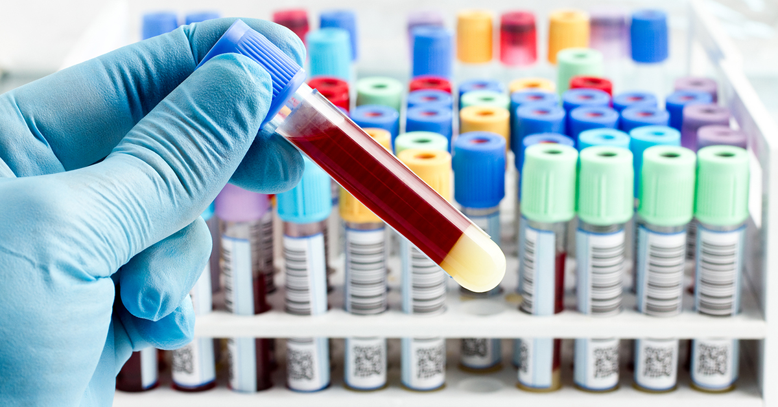
Progress!
Epistemology
Methodology
  Mappings
  Units of analysis
Implications
Summarising
Notes:
Making some progress!

Slide 10
Differences (measurement)
Blood tests
We believe we have methods to map from concentrations to numbers
Methods might be chemical or immunological
Might map via colours or electricity
But end up with numbers that reflect concentrations
Questionnaires
We have ways to ask people to map from their internal states to numbers:
  VAS and other single ratings
  Multi-item scales
  More complex methods
We have no idea how the numbers we get map to the internal states
But we have statistics and psychometrics

Slide 11
Differences (maths)
Blood tests
We believe we understand the measurement methods (e.g. glucose sticks)
We know they’re not perfect and perhaps non-linear
But we have many statistical ways to test their quality
Questionnaires
We don’t know how people map from their internal states to answer q’aires
So we turn to statistics and psychometrics

Slide 12
Measurement quality (blood)
Reliability: retest (and again and again to catch calibration drift if a laboratory machine)
Accuracy/validity: test mean against range of known concentrations
Linearity: plot against known concentrations (non-linear but regular is fine: pH)

Slide 13
Measurement quality (blood)
We conclude within whatever epistemological position, that our numbers reflect blood concentrations
  We can map cheap measures to referential ones
  Where needed (screening) we can achieve very high precision and reliability even in the cheap measure and also use that to step from screening to definitive measurement
  We can get predictive validity and utility as we start from very good measures

Slide 14
Measurement quality (q’aires)
We seem to have the same:
  Reliability
  Validity
Reliability:
  Internal (for multi-item measures)
  Test-retest (for any but assume no true change)
  Inter-rater (for rater/interview/observer measures)
Validity: hm, we have no known values for the internal states so this is messy!
Linearity? Impossible to judge?

Slide 15
Validity (psychometric)
Content (overlaps with construct)
  Face (subset of content, whose face(s)?)
Construct
  Simple
  Sophisticated
Convergent/divergent
Criterion (subset of convergent really)
Predictive (have you ever seen this explored?)

Slide 16
Validity (psychometric) #2
Internal (within the study)
External (across studies)
Ecological (about practical generalisability)

Slide 17
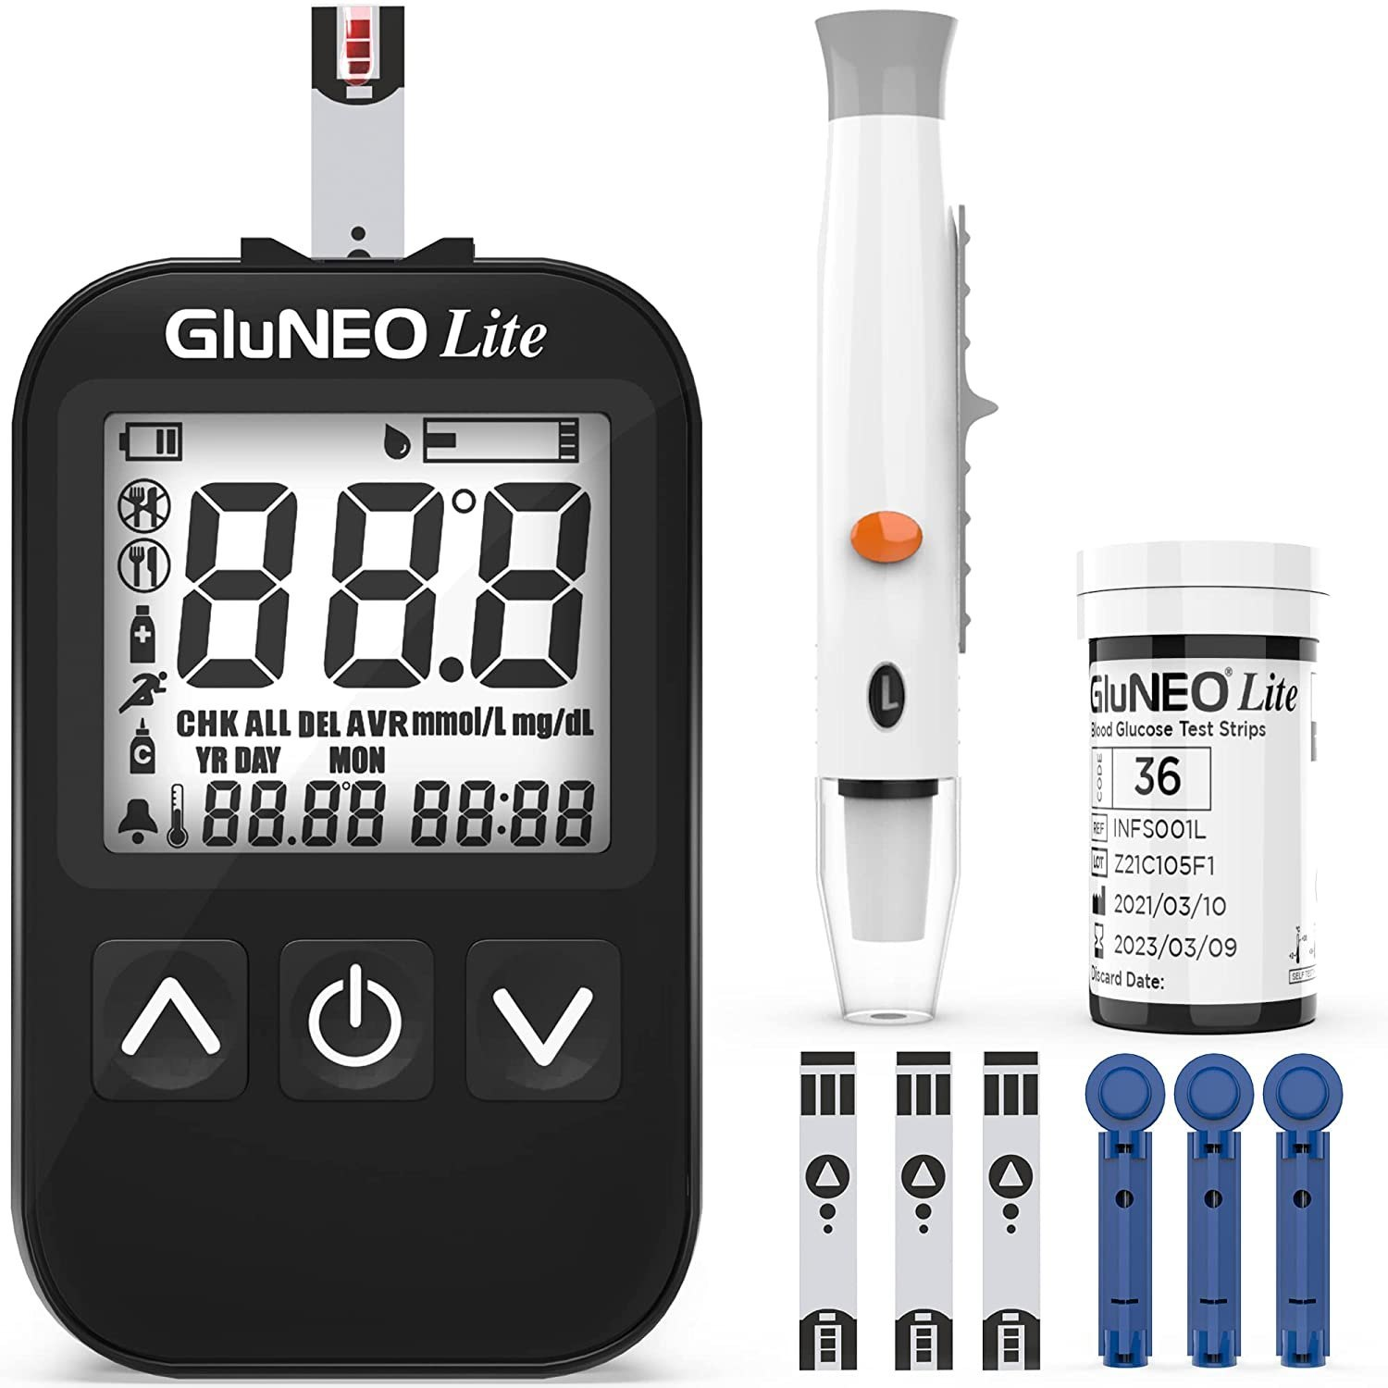
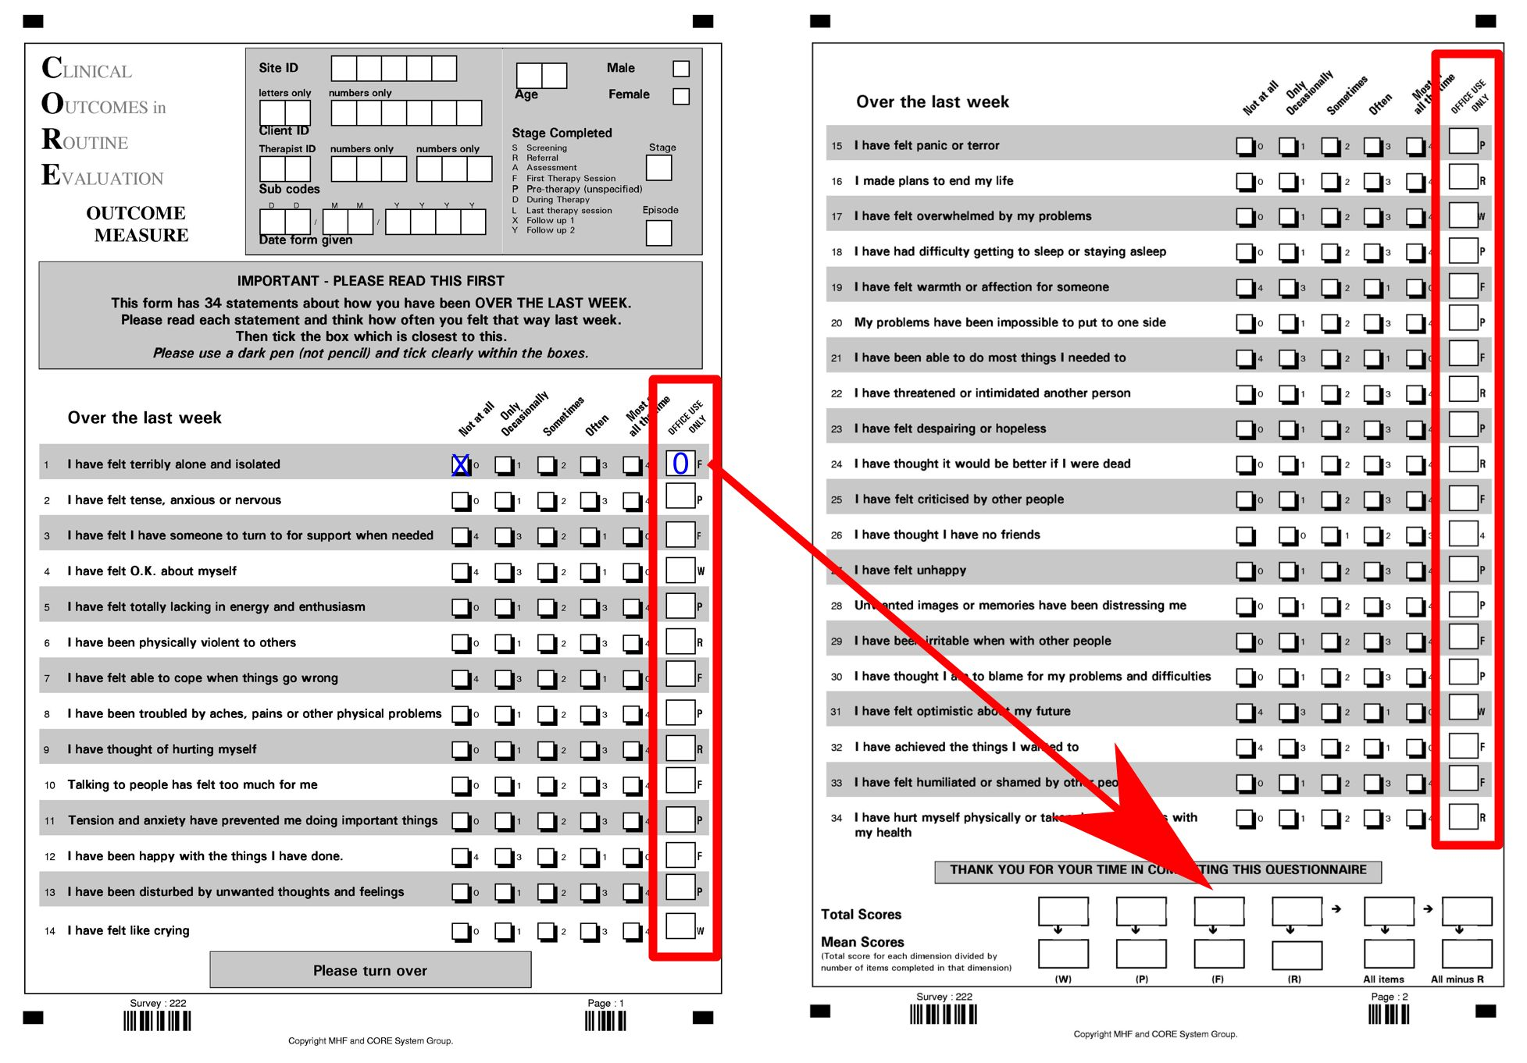
Progress!
Epistemology
Methodology
  Mappings
  Units of analysis
Implications
Summarising

Slide 18
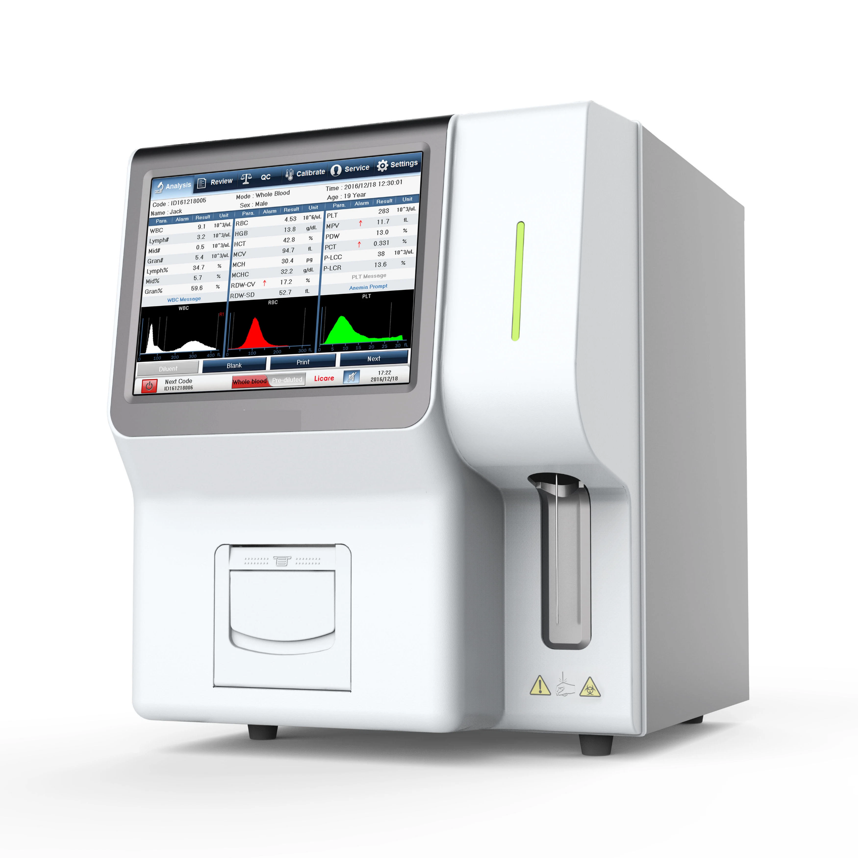
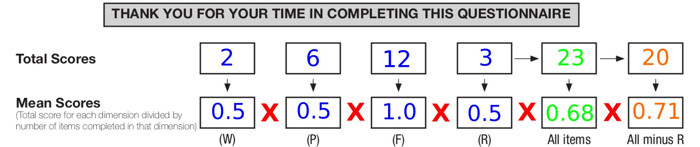
Progress!
Epistemology
Methodology
  Mappings (advanced bit)
  Units of analysis
Implications
Summarising

Slide 19
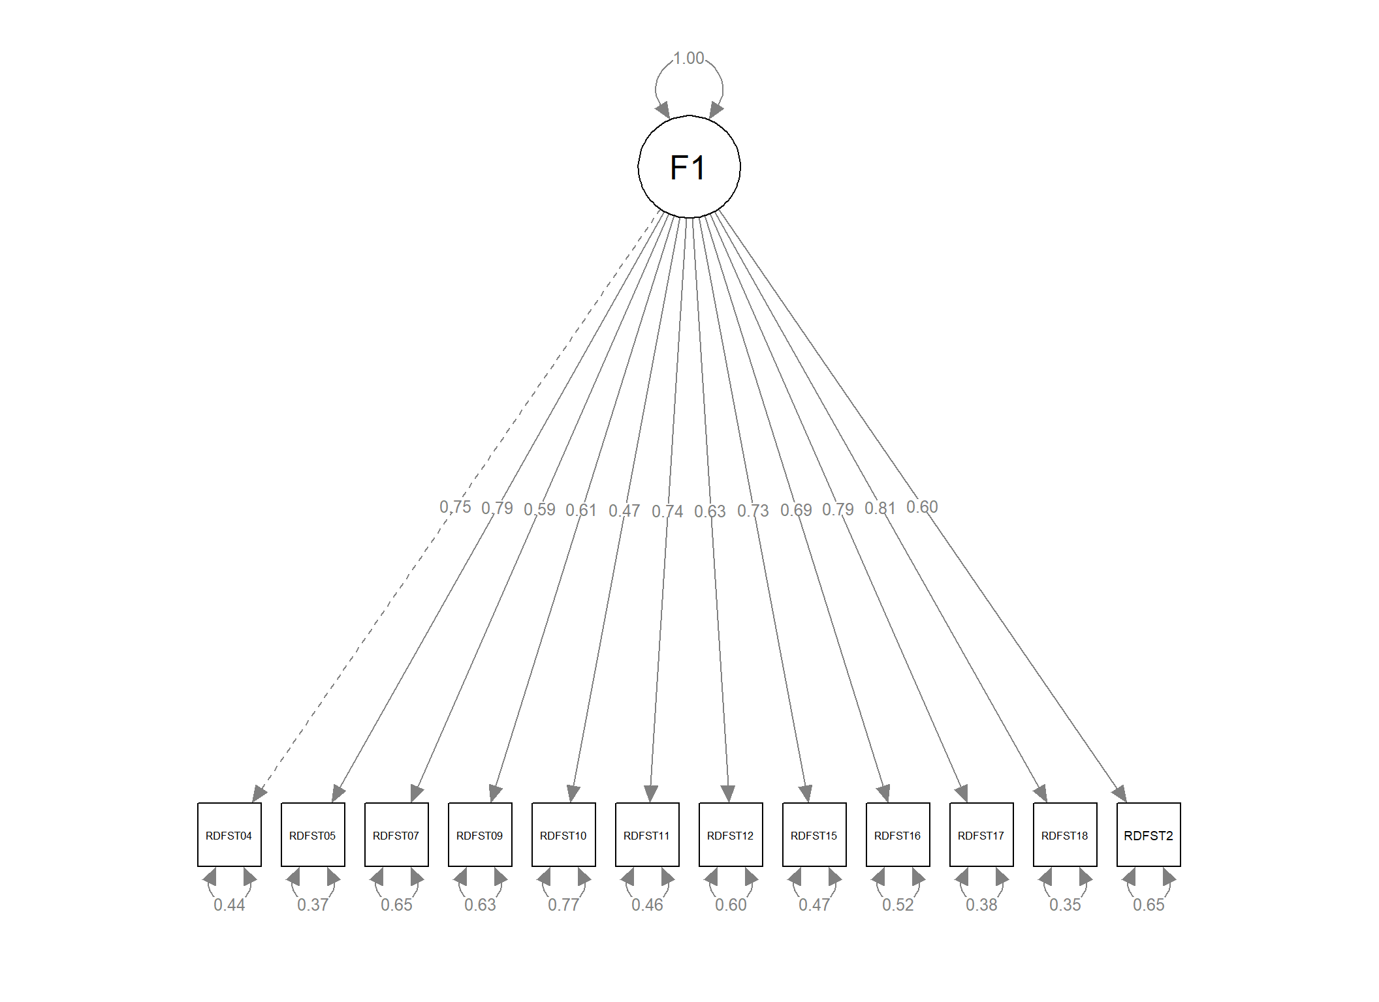
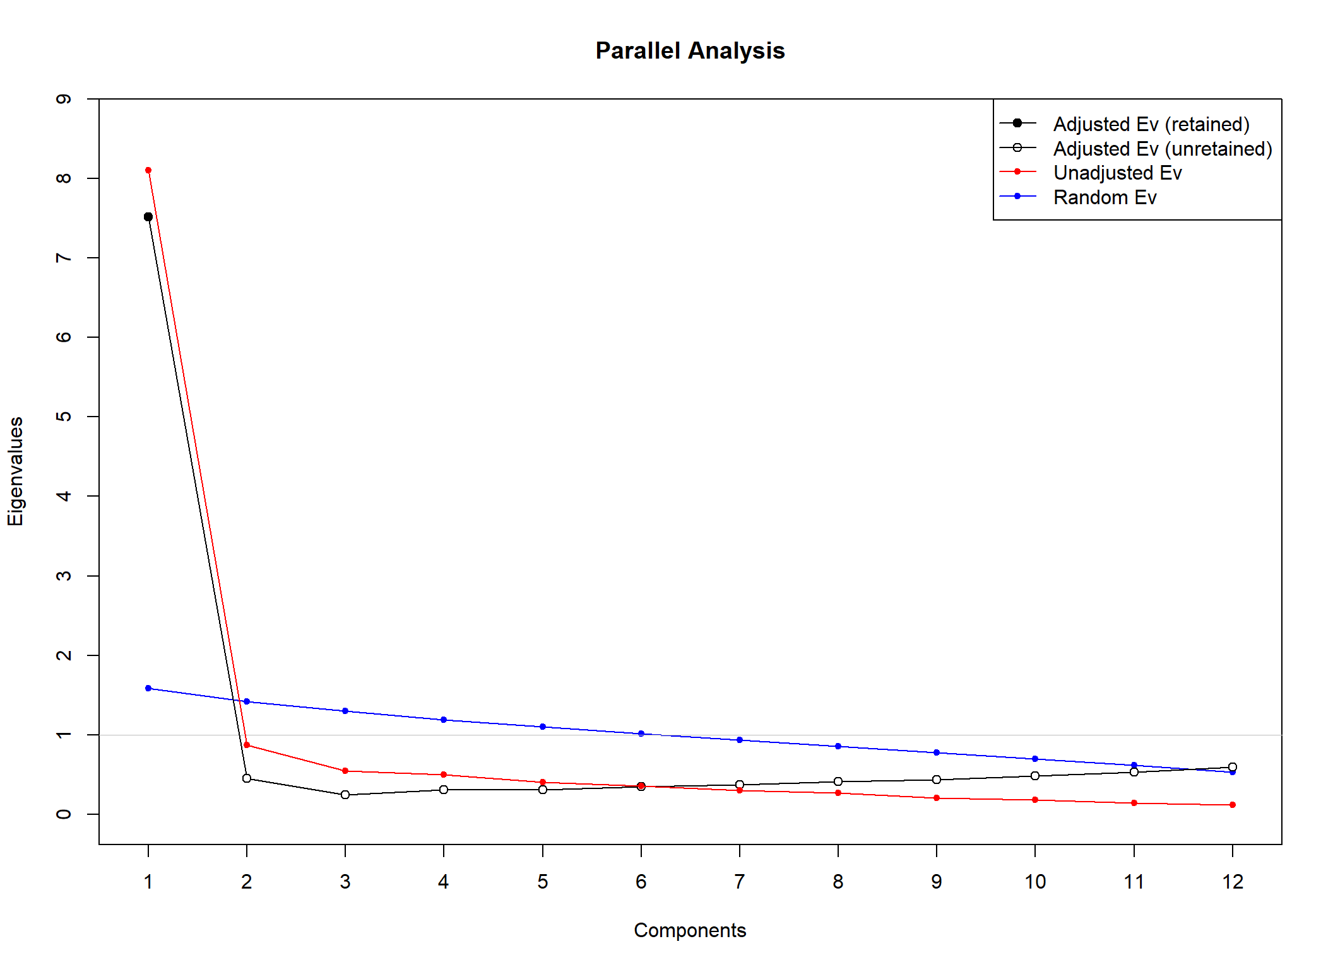
Latent variable models
Methodology
Notes:
The talk was for an audience mostly of undergraduate students so I summarised this by saying that these methods are very powerful but rather seductive.

Slide 20
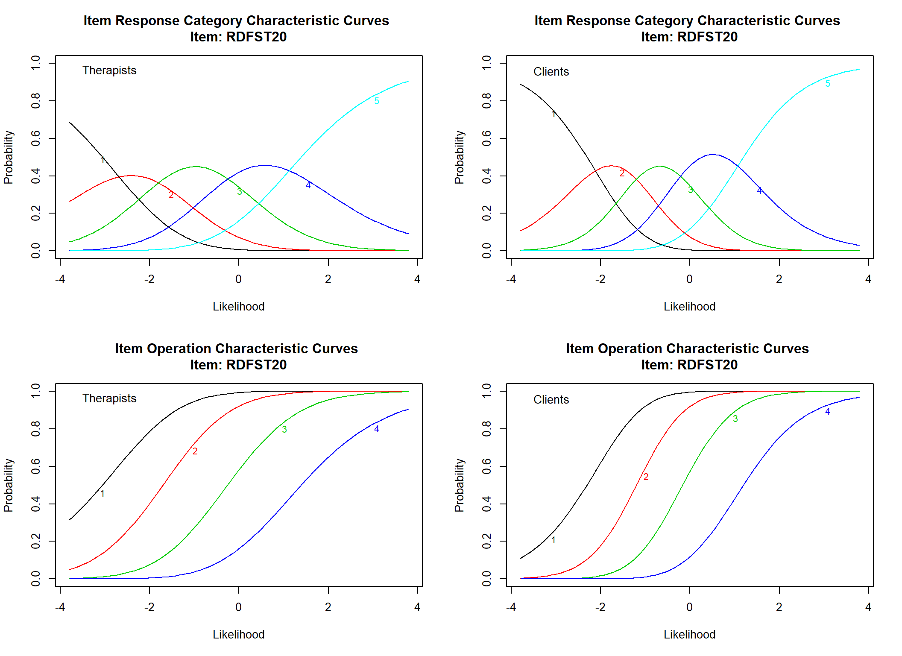
Summarising latent variable models
Our currently dominant methods that seem to map evaluation of questionnaire data to evaluation of physical measurements are large n commonality models only

Slide 21
Progress!
Epistemology
Methodology
  (Back to) Mappings
  Units of analysis
Implications
Summarising

Slide 22
Mapping for how many participants/clients?

Slide 23
n = 1 versus n ≫ 1
“Individual vs. group/sample/population”
“Unit of analysis”
“Idiographic vs. nomothetic”
“Individual vs. aggregated”
Notes:
With hindsight I think “unit of analysis” is not the ideal heading here as it’s particularly about the way we take ideas about questionnaires “having” reliability and validity as if they were natural science measurements from aggregate data analyses and we then often apply them to single individual’s responses which is a potentially dangerous mismatch as we have no reason to expect that this individual is using the measure in the way that some sufficient majority of the respondents did in the “validation study” for the measure. (I hate that idea of “validated measures” and “validation studies” but love people who do good studies that I call “psychometric explorations” and who don’t overstate what they have found as if it will apply for everyone using the measure. (Sadly, I have written some such reports in my earlier days.)

Slide 24
n = 1 versus n ≫ 1
Statistically these are very different particularly when scores are unreliable
  Aggregation, for which we need n ≫ 1, improves reliability as it retrieves signal from noise (hence internal reliability)
  So a score for one person is as unreliable as scores can be
  But if all scores are from same person we can sidestep some issues (for another talk!)

Slide 25
Summary
Psychometric methods try to map analysis of multi-item measures to that of blood tests
Useful to find commonalities across people for use of measures to rate those commonalities
Unlike blood tests this tells us nothing about using the measures within individuals for change measurement

Slide 26
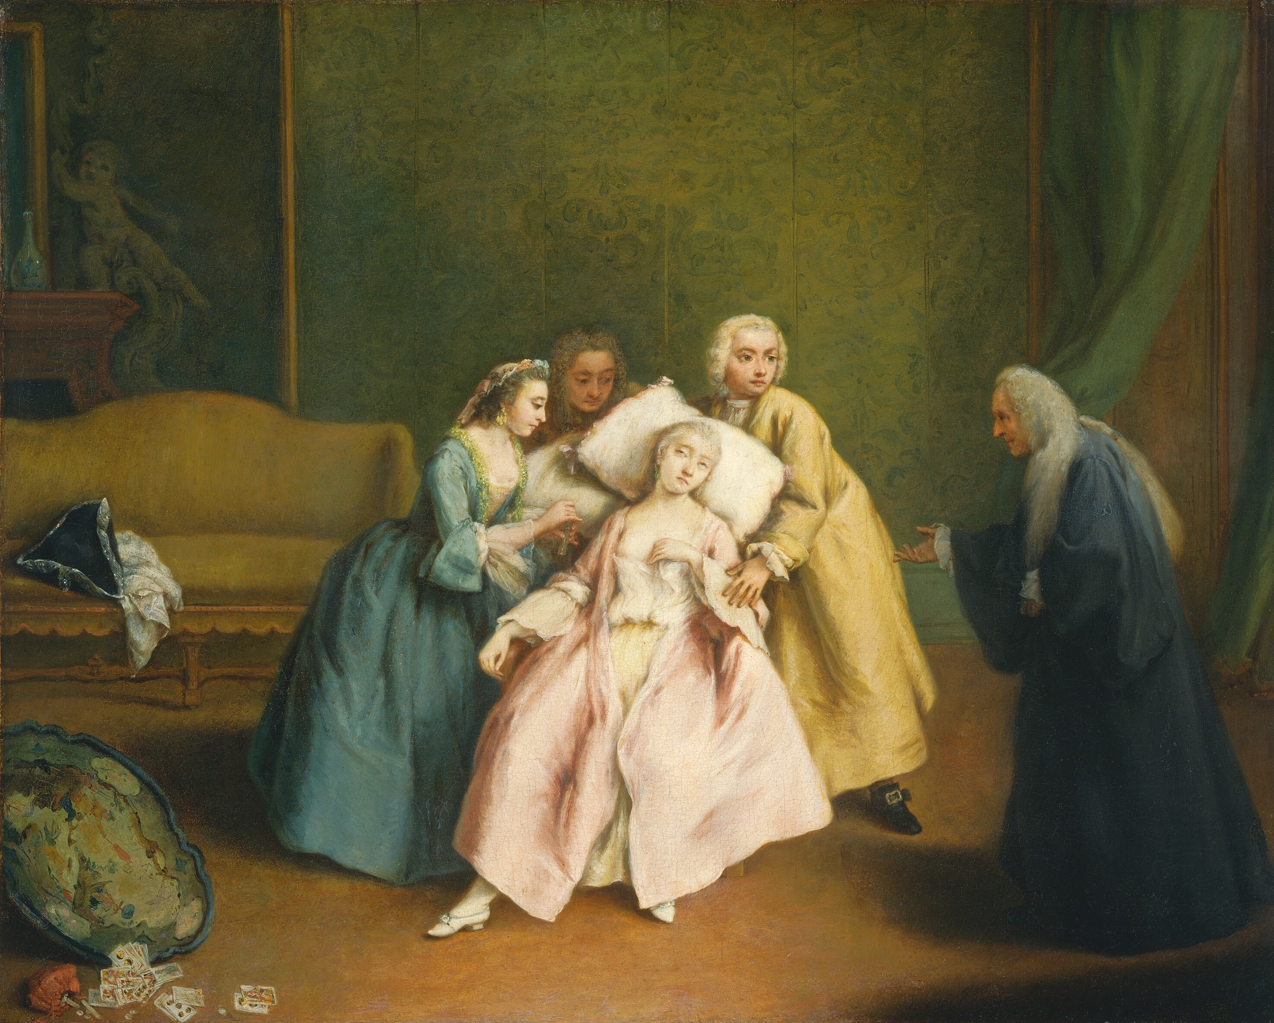
Progress!
Epistemology
Methodology
  Mappings
  Units of analysis
Implications
Summarising
Pietro Longhi (1701-1785)
Notes:
We had to stop here in Quito as, though I had timed the talk, talking very slowly, to 23 minutes, with sequential interpretation (by a lovely interpreter, Yvette), I had used 40 of the 50 minutes by here so I encouraged people there who were interested to get the full talk but explained that the rest of the talk was running through the implications of what I had been arguing.

Slide 27

Does this matter?
Pragmatic evidential value
Distinguish use for n = 1 from n ≫ 1 use

Slide 28

Utility of tests #1: Blood tests
Someone in a crowd falls over unconscious
Someone else with diabetes sees the medicalert bracelet saying “diabetes” and does a quick fingerprick “glucostix” test
What will it tell A&E?

Slide 29

Utility of tests #1: Blood tests
Glucose in the …
  Normal range: coma is probably not diabetic
  Low: start giving glucose (or glucagon)
  High: start hydrating and bringing glucose down (more complicated than this but that’s a good start)

Slide 30
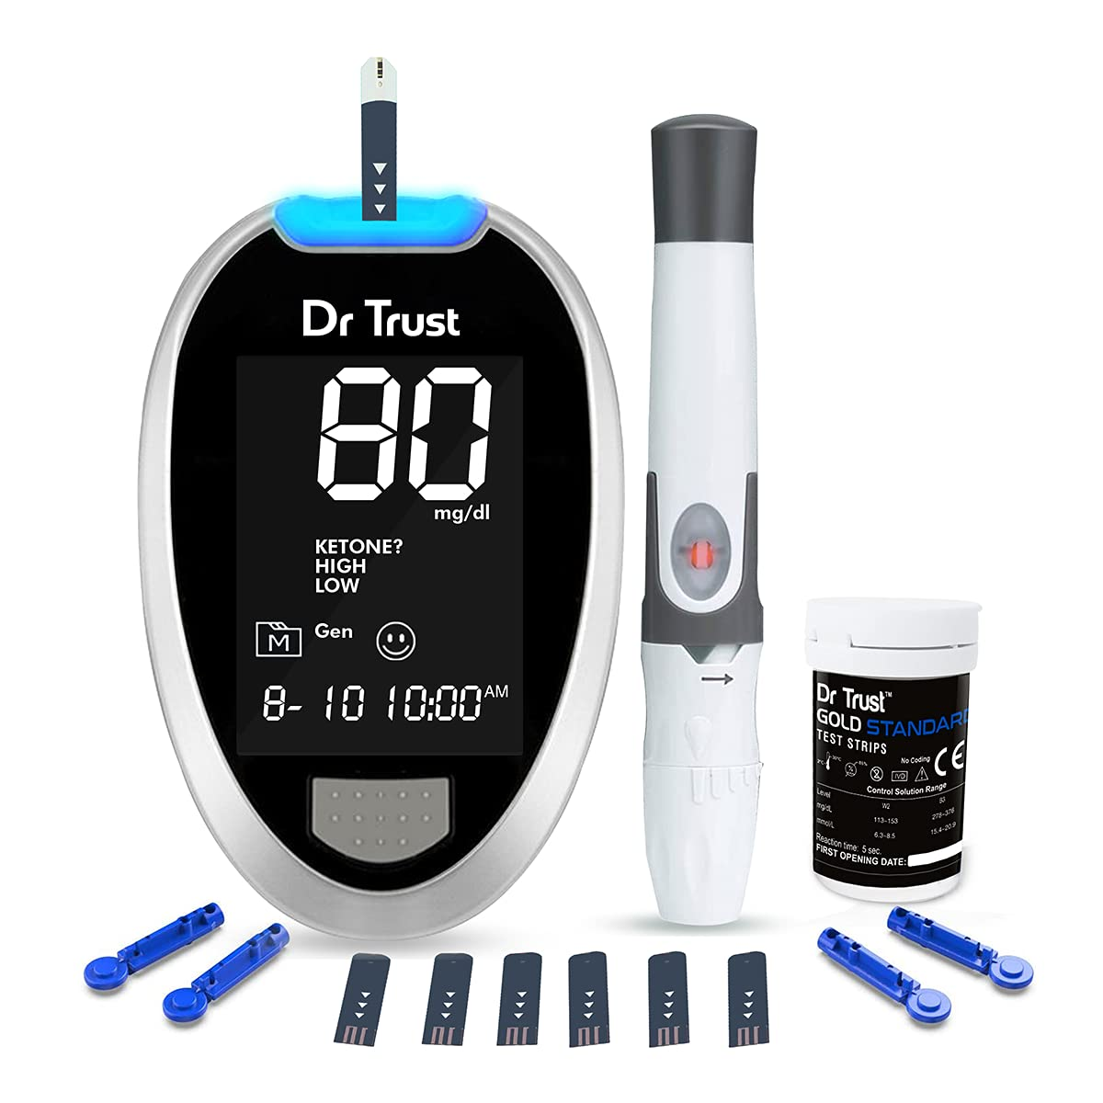
Utility of tests #1: Blood tests
Person who collapsed had a blood glucose level of .2 mmol/l
So this was a hypoglycaemic crisis/coma
What more data/information does the family doctor want?
Notes:
“PwDM” = Person with Diabetes (Mellitus)

Slide 31
Utility #2: someone seeks psychological help …
What more data do we need/want?

Slide 32
Working with the individual
In both cases we will want to explore:
  How the person understands the problems.
  The personal resources they have for this.
  Their family, intimate, work and social relationships that will help or hinder them.
  How all this means I can best work with them.
  How we might monitor that work: what data will help us?

Slide 33
Data to monitor this work
PwDM
Blood glucose levels
HbA1c
Weight/BMI
Many “hard” tests for consequences of DM
Diet
Lifestyle
Adherence to agreed regime
… and all of this →→→
PwPsyT
Body language
Verbal language: form
Verbal language: content
Reported life outside the sessions
? “Collateral” information
Measures, “psychometric measures”

Slide 34


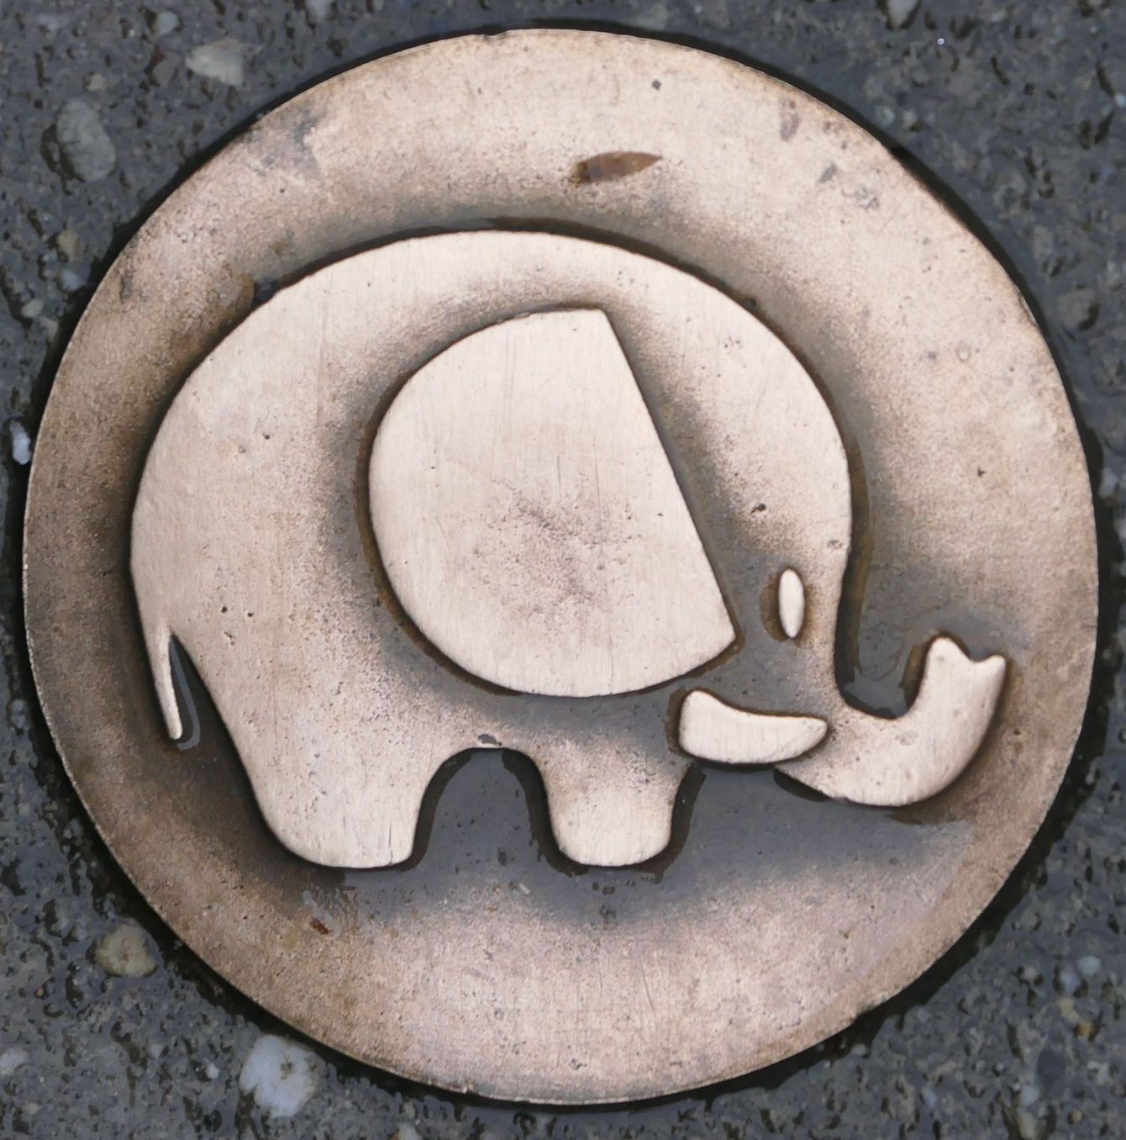
Progress!
Epistemology
Methodology
  Mappings
  Units of analysis
Implications
Summarising

Slide 35
Both have a shared risk
Can overvalue the numbers and detach then from their meaning & utility
  Blood tests
    Relentless focus on the values can risk losing the whole person and their wishes:
      Blood glucose but also …
      … cancer markers?
  Questionnaire scores
    Can’t assume that what matters to the client is covered by the measure
    Can’t assume that the client just wants to be completely “honest” in responding

Slide 36

References
Email me: chris@psyctc.org !

Slide 37
Thanks!
Resources
  OMbook: https://ombook.psyctc.org/book/
  Glossary: https://www.psyctc.org/psyctc/book/glossary/
  CORE site: https://www.coresystemtrust.org.uk/
  Spanish: https://www.coresystemtrust.org.uk/espanol/
  Rblog: https://www.psyctc.org/Rblog/
  Shiny apps: https://shiny.psyctc.org/
  CECPfuns: https://cecpfuns.psyctc.org/
chris@psyctc.org

